Slide 1
Women in Conflict: Do Women in Political Power Approach Conflict Differently?
Sam Lee

Slide 2
What is the effect that electing women has on reducing armed conflict within African and Arab nations?

Slide 3
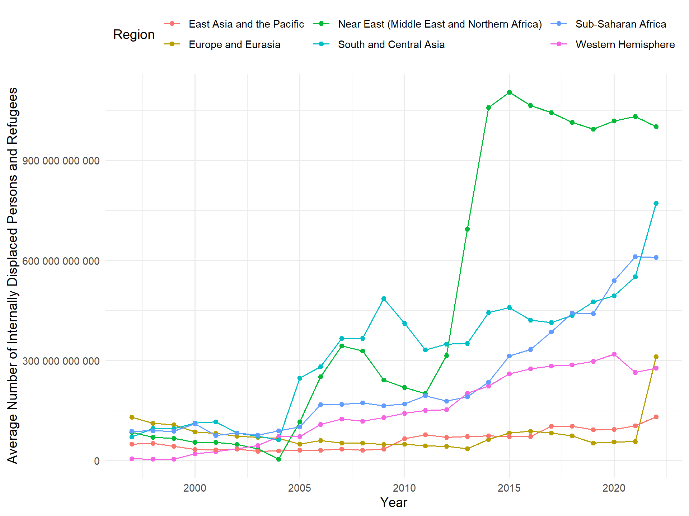
Background

Slide 4
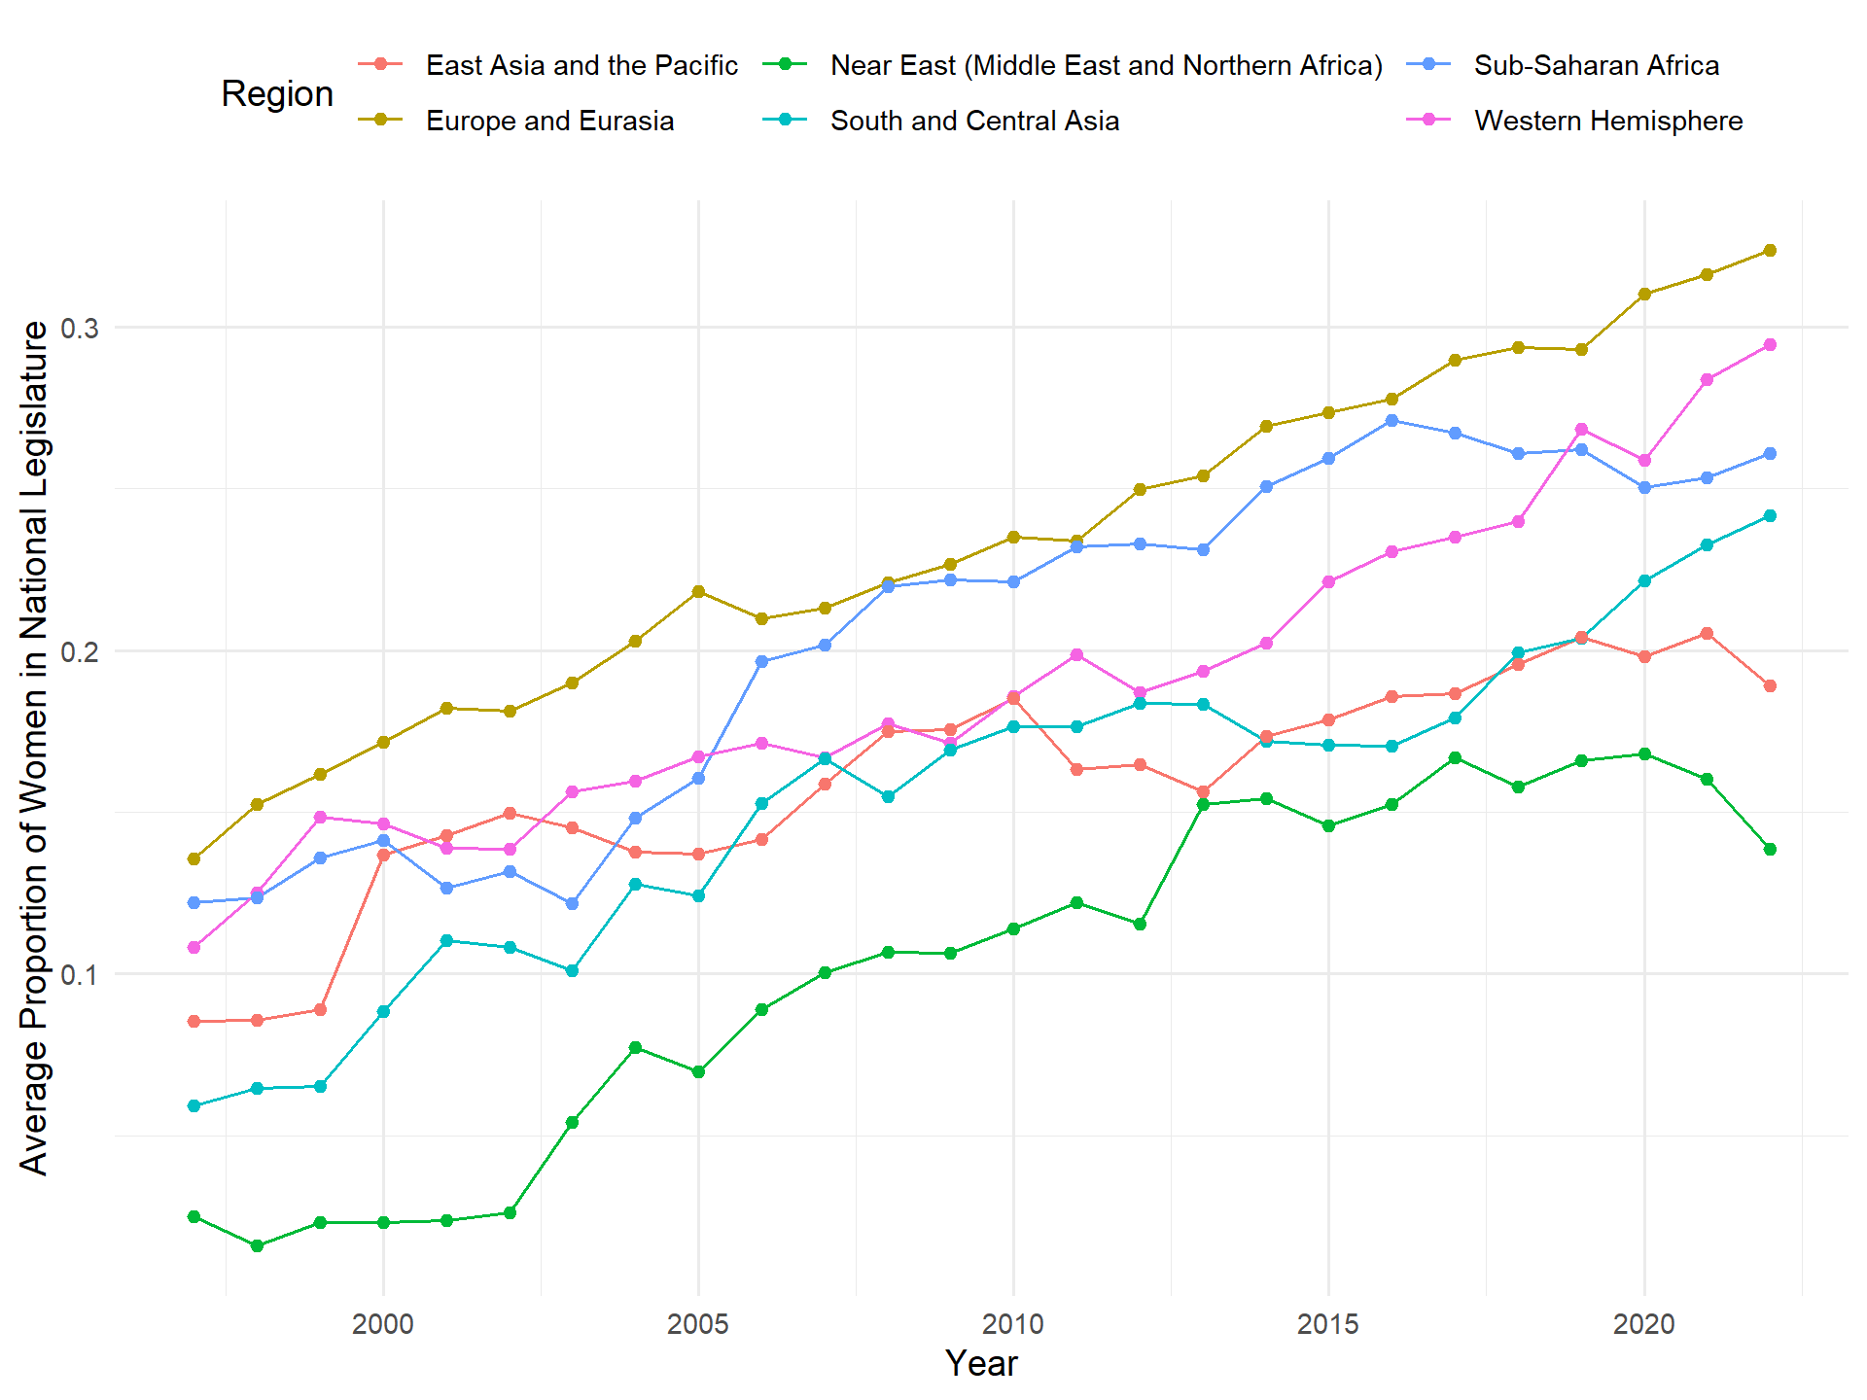
Background

Slide 5
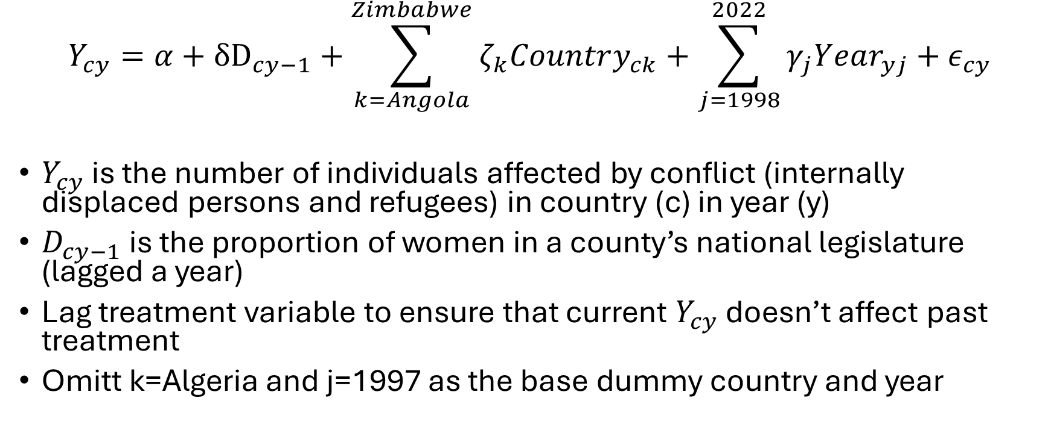
Estimation – Difference in Differences
$$Y_{cy}=α+{δD}_{cy−1}+\sum_{k=Angola}^{Zimbabwe}{ζ_{k}Country_{ck}}+\sum_{j=1998}^{2022}{γ_{j}Year_{yj}+ε_{cy}}$$
$Y_{cy}$ is the number of individuals affected by conflict (internally displaced persons and refugees) in country (c) in year (y)
$D_{cy−1}$ is the proportion of women in a county’s national legislature (lagged a year)
Lag treatment variable to ensure that current $Y_{cy}$ doesn’t affect past treatment
Omitt k=Algeria and j=1997 as the base dummy country and year

Slide 6
Estimation—Assumptions
In the absence of more (or less) women being elected, the average number of individuals affected by conflict for each country would have followed the same trend over time as the other countries that did not elect more (or less) women in national legislatures at that specific time.
No other events or factors are influencing the outcome variable (internally displaced persons) differently across groups over time.
No unobserved heterogeneity (robust to omitted covariates)

Slide 7
Data
[1] UN Refugee Agency (UNHCR)
IDP for each country over time
[2] Inter-Parliamentary Union (IPU)
Women in national legislature over time
[3] U.S. Department of State
Regional Definitions
[4] The World Bank
Additional covariates (population, GDP)

Slide 8
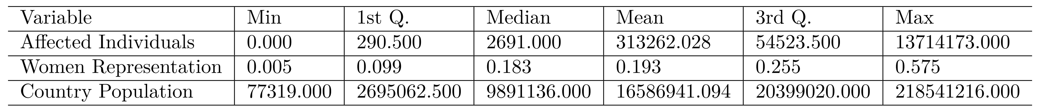
Summary Statistics

